Slide 1
Welcome to today’s collective worship.
Let’s start by saying together the Lord’s Prayer.
The theme of today’s collective worship is “In the News”. We will be looking at COP 27 and our Let’s Go Zero pledge.

Slide 2
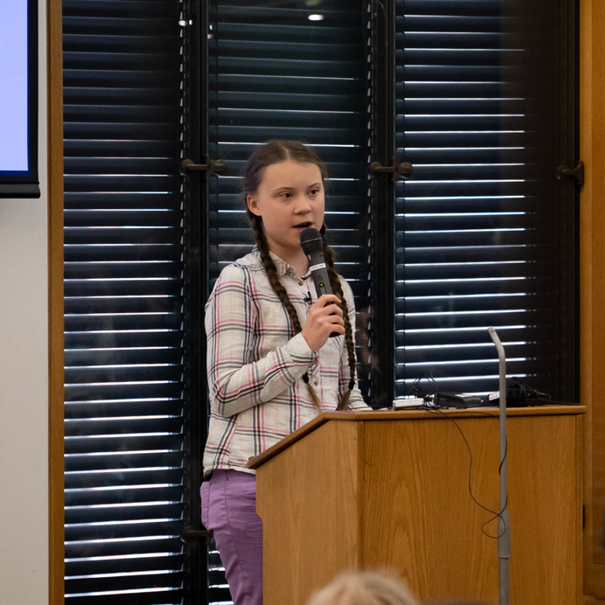
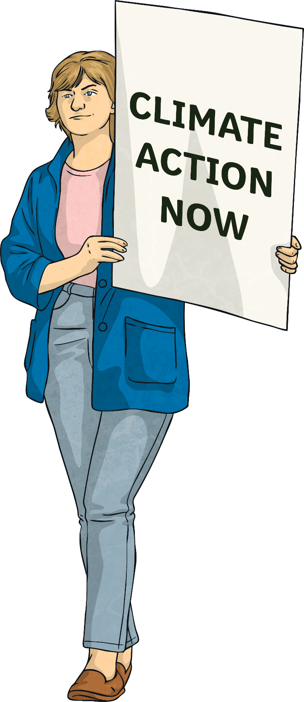
COP27 – Our Climate Our Future
Our planet is in crisis and the world must come together to find solutions.

Slide 3
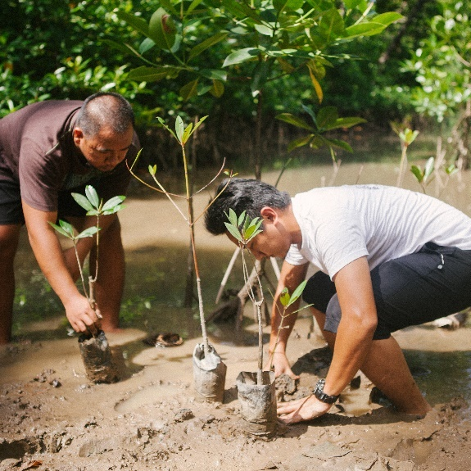
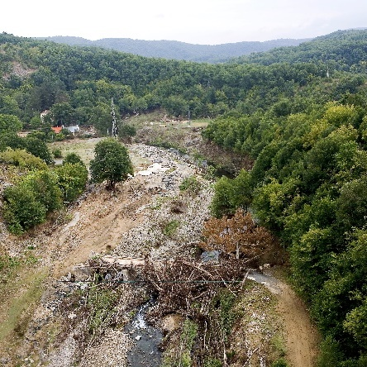
COP27 – Our Climate Our Future
The United Nations (UN) is an international organisation that comprises the majority of countries around the world that are willing to work together to discuss global problems. They identify ways to overcome them in order to benefit the entire planet.
Climate change is one of those problems. In fact, it is a huge issue affecting the whole world and all of humanity: real people; precious animals; delicate ecosystems and, in fact, all living things.

Slide 4
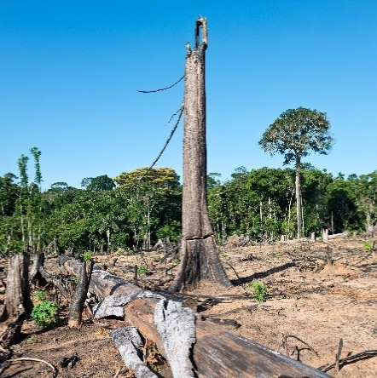
COP27 – Our Climate Our Future
The issue of global warming has been recognised for many years. As far back as 1979, the very first World Climate Conference took place.
Over the last 25 years, 197 people and organisations (known as parties) from almost every country in the world, including the European Union, have met at an annual conference to talk about reducing the human impact on the planet’s climate.
This is known as the Conference of the Parties (COP) and COP27 will be the 27th meeting.

Slide 5
Let’s Go Zero
https://www.youtube.com/watch?v=dAVPqzTafZI
Last week Pupil Parliament asked every class to write 5 ways in which they can help out school go Carbon Zero for 2030. Mrs Sherwood collated all your ideas and the most popular ones will be out St Thomas’ Pledge.

Slide 6
St Thomas’ Let’s Go Zero Pledge
We will walk to and from school more.
We will turn off the lights when they are not needed.
We won’t waste paper and use the paper recycle bins properly.
We won’t drop litter, we will put in in the bin.
We will turn off plug sockets when not needed.
We will close the playtime door.
We will turn the water taps off.
We will not waste food

Slide 7
Let’s us finish with quiet reflection and then say the school prayer.

