Slide 1
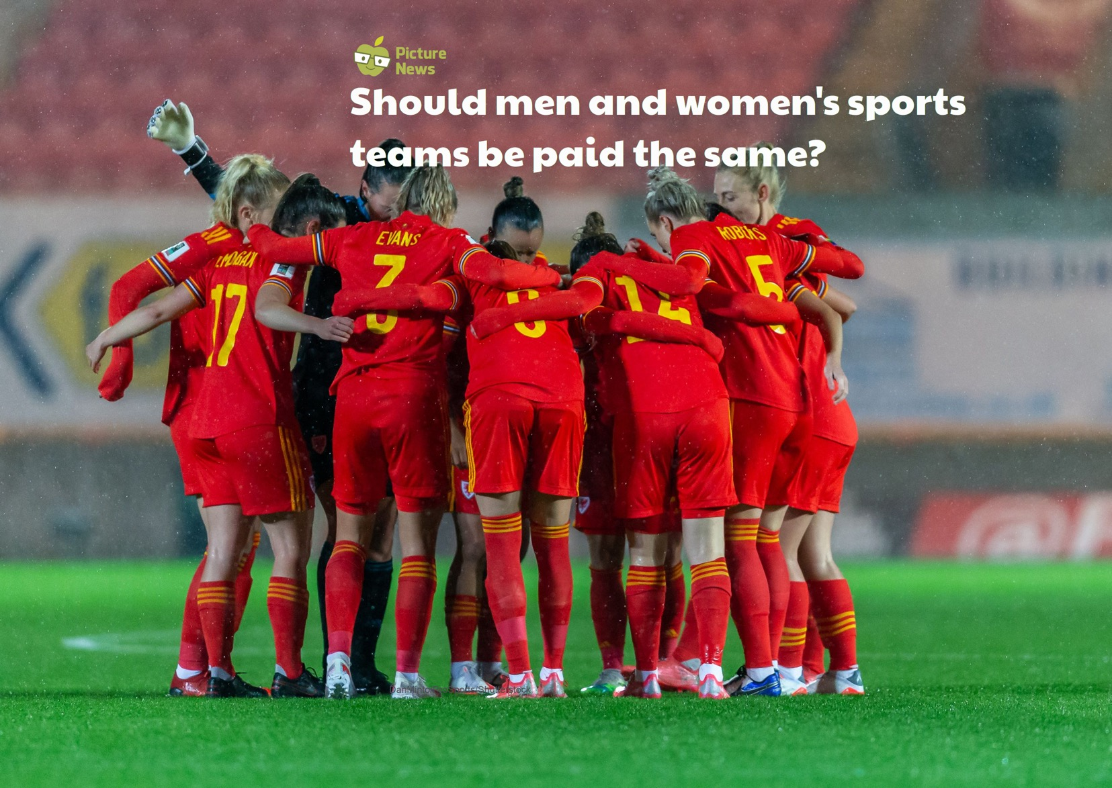

Slide 2
All people equal
Core Value: Respect
God
Creation
Fall
People of God
Incarnation
Gospel
Salvation
Kingdom of God
© Picture News 2023

Slide 3
The Welsh Football Association has announced that the national men's and women's football teams will be paid equally moving forward. Wales joins a list of other countries including Australia, USA, Norway, and Brazil, who pay their men and women football players the same amount to play for their country's national team. In order to reach the deal, the Wales men's senior team agreed to a 25% pay cut, thus enabling a 25% rise for the women's team, which now brings them both equal on pay.

Slide 4
Think together and talk
Do you think you have ever been treated unfairly? Do you know why you were treated this way?
Can you explain what equal rights are?
What can you do if you see someone being treated unfairly or not given equal rights? What can you do if this happens to you?

Slide 5
The Bible clearly tells us that all humans are equal. They share in equal rights and are all equally worthy of honour and respect. Jesus challenges us about how to live. He sets the example for loving God and your neighbour and putting others first. He also teaches us to challenge individuals and social structures, that do not treat all humans equally.

Slide 6
There is neither Jew nor Gentile, neither slave nor free, nor is there male and female, for you are all one in Christ Jesus.
Galatians 3.28

Slide 8
...the Government must not think that they can stop this agitation. It will go on...We are here not because we are law-breakers; we are here in our efforts to become law-makers.
Emmeline Pankhurst – political activist for women’s suffrage

Slide 9
Protected
Characteristics
Both men and women should be treated fairly. This includes being paid fairly for the job they do.
© Picture News 2023

Slide 10
UN Rights
of a Child
All children have rights and should not be treated unfairly for any reason. This includes whether we are a girl or a boy.
© Picture News 2023

Slide 11
Prayer
Dear God,
Thank you for teaching us kindness, fairness and love for everyone.
Give us the courage to stand up for the things we believe are right.
Help us to build a world that values all people equally.
Amen

